Slide 1


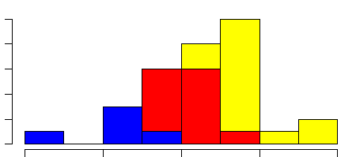
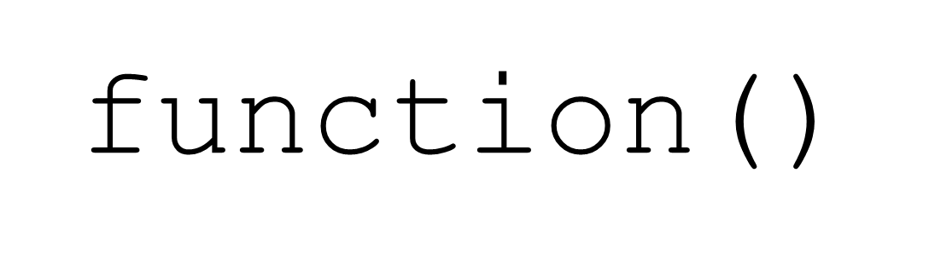
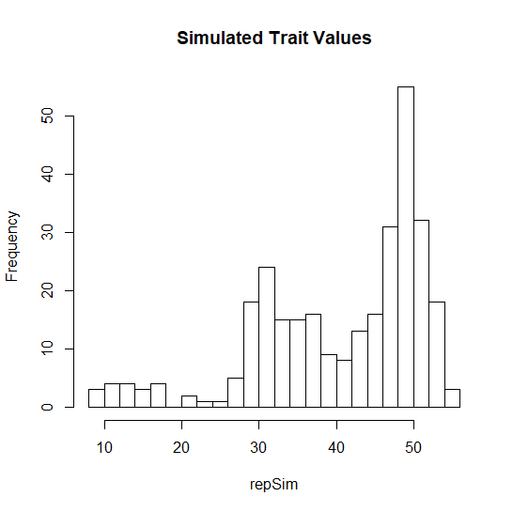
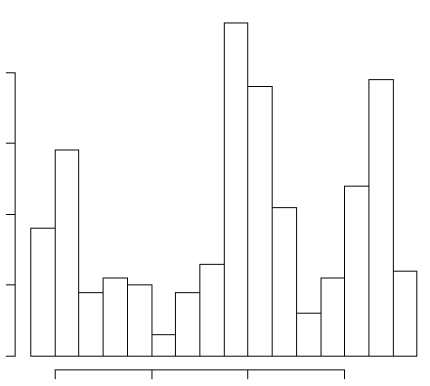
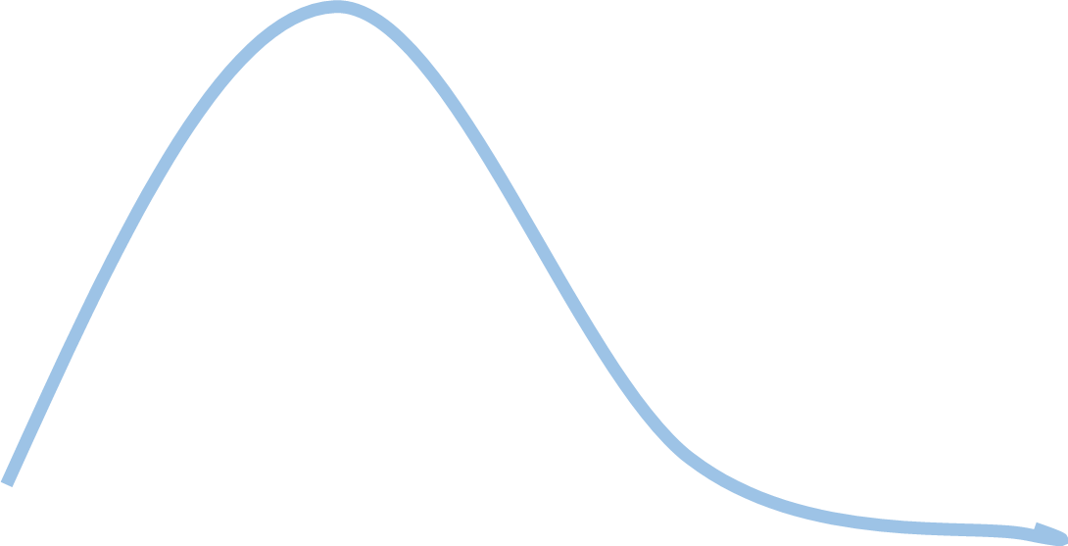
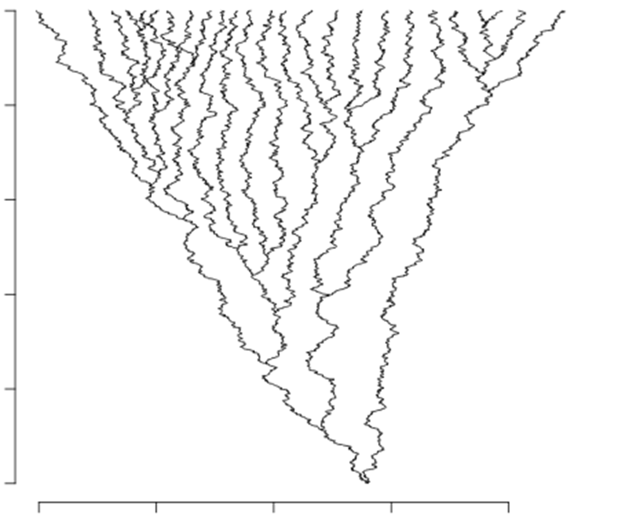
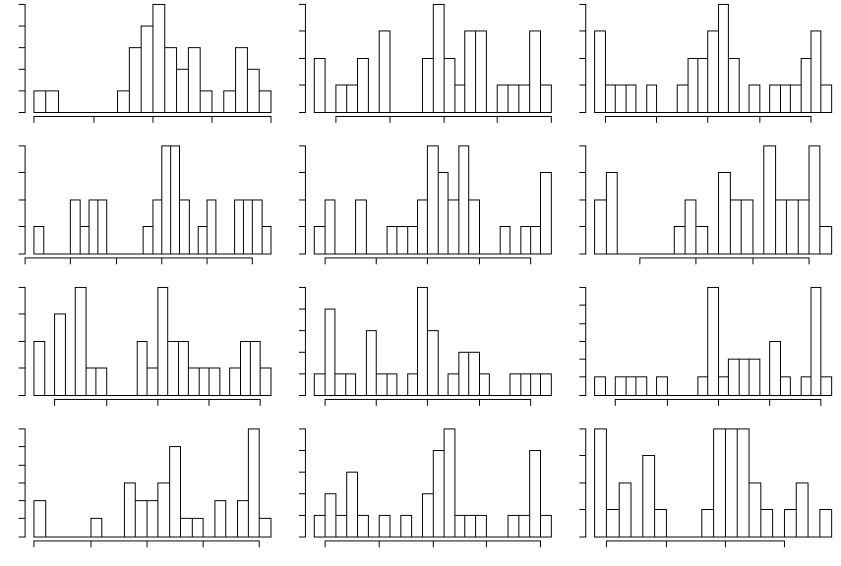
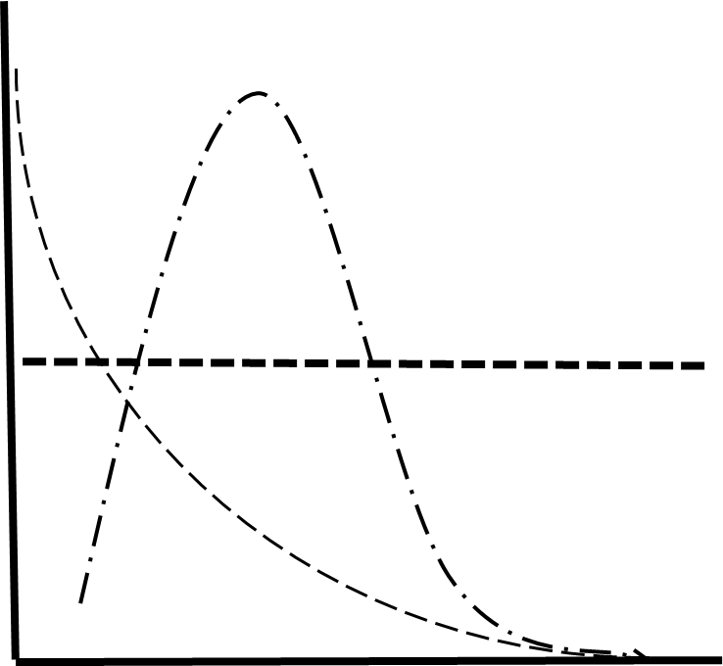

If You Can Simulate It, You Can Fit It
Do-It-Yourself Phylogenetic Models of Trait Evolution for the Fossil Record with the R Package TreEvo
David Bapst, Brian O’Meara & Barbara Branbury
The Problem
Modeling Trait Evolution with TreEvo
Pollinator Regimes with different optima, unidirectional bounds…
X_{t} ~ X_{t-1} + Intrinsic Δ + Extrinsic Δ
Aquilegia: Floral Spur Length
Arbitrary Optima
Parameter Estimates?
Example
Example
Whittall and Hodges, 2007
Character Displacement
Bound
Bound
Model Likelihood = ???
Time
Trait
Aquilegia: Floral Spur Length
Trait
The Solution: Approximate Bayesian Computation (ABC)
Limits of ABC
Slow
Identifiability
Trait evolution models should be match our biological understanding, not methodological limits. What new models can you imagine?
Draw New Parameter Values
Parameter Estimates
Priors
Posterior
Prior
Simulate Trait Change On Input Tree
Ancestral State
Posterior
Compare For Acceptance to Posterior
Prior
Summary Statistics λ, α, β, δ, ρ, μ, ¥, §… etc (Reduced with PLSR)
For the package, see: https://github.com/bomeara/treevo
Rate of Change

Slide 2
Limits of ABC
Slow
Identifiability
TreEvo allows our models to be limited by our biological understanding, not methodological limits. What new models can you imagine?
Arbitrary Optima
Trait
https://github.com/bomeara/treevo
Yes it works fine for fossil trees
Only limit to fitting models of trait evolution with TreEvo is our ability to describe them as function of trait change per time step. What models can you imagine?

Slide 3
The Problem: Approximate Bayesian Computation
Approximate Bayesian Computation
Approximate Bayesian Computation

Slide 4
Pollinator Regimes with different optima, unidirectional bounds…
Aquilegia: Floral Spur Length
Whittall and Hodges, 2007
Bound
Bound
Aquilegia: Floral Spur Length
Bound
Bound
Bound
Bound
Aquilegia: Floral Spur Length
Aquilegia: Floral Spur Length

Slide 5
Can’t calculate the likelihood of trait data for some model of evolution? Brute force it with simulations.

Slide 6
Modern phylogenetic comparative methods (PCMs) are often used to compare the fit of alternative models of trait evolution, usually limited to the small set of models for which we can calculate likelihoods for. Many of our qualitative explanations of trait evolution for a particular scenario are much more complicated than the simple, mathematically tractable models. Model selection approaches in PCMs can be a red herring, however, often preferring more complex models with outlandish or imperceptibly small parameter values. A better, truly Bayesian approach would be to fit complex, generalized models tailored for the specific evolutionary scenario we are interested in, and then assess parameter estimates for whether they support a significant role for evolutionary processes of interest. Approximate Bayesian Computation (ABC) assesses the fit of models via summary statistics, allowing us to use any model that we can simulate data from. Thus, the only real limits to ABC are the computational cost of repeating those simulations, and whether we our data and summary statistics are sufficient to obtain precise and accurate parameter values. We have implemented an ABC approach in the R package TreEvo, which allows users to write their own functions describing trait change at a given time-step, allowing for models that incorporate competitive exclusion, heterogeneous rates of trait change, multi-optima models of macroevolutionary landscapes, directional trends, and combinations thereof. We will present the application of TreEvo to fossil datasets with dated phylogenies, as well as analyses of simulated datasets to demonstrate the utility and limits of the ABC approach.

Slide 7
Limits of ABC
Slow
Sufficient Summary Statistics

Slide 8
X(t) ~ X(t-1) + Intrinsic Change + Extrinsic Change
X_{t} ~ X_{t-1} + Intrinsic Δ + Extrinsic Δ

Slide 10
Root state
Brownian rate
Notes:
Here you can see, for the above example of thirty taxa, the final estimates. The prior probabilities given were the grey distributions (uniform). The true values used were the blue lines. The pink distributions are the posterior probabilities, with the red line the mean and the dotted lines showing the 95% highest probability density region (the gray lines show the corresponding intervals for the prior). Okay, but that’s brownian motion: boring.

